Slide 1
PARALLEL PARTICLE FILTER
MATTEO PINTAUDI - 179030

Slide 2
Recap
Particle Filter -> Algorithm
OpenMP -> API for parallel programming
Rviz2 -> ROS graphical interface
Gprof -> profiler

Slide 3
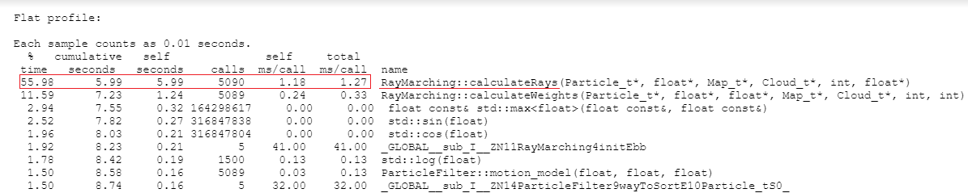
Profiling
The code was run 5 times to gain more accuracy
«calculateRays() is the bottleneck
Clock() -> 3.94 s

Slide 4
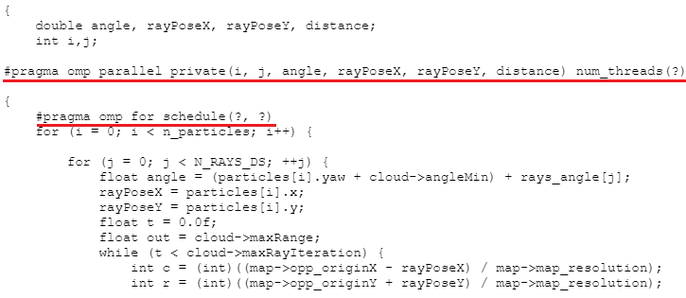
Possible optimization
Schedule(static, 1) + num_threads(1) = 3.97 s

Slide 5
Static scheduling

Slide 6
Dynamic scheduling

Slide 7
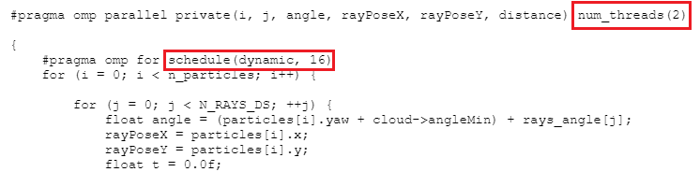
Optimization
Schedule (static, 32) + num_threads(2) → 6,18 s
Schedule (dynamic, 16) + num_threads(2) → 5,99 s

